Slide 1
The Australian Priority Investment Approach
29 May 2017

Slide 2
Australia’s Social Security System
Non-contributory, means-tested system with welfare payments funded by general taxation revenue.
Welfare spending represents a significant proportion of government spending.
Care services and other areas of social spending are also growing.
Important to maintain a well-targeted, equitable and affordable system – these are key elements to maintain community support.

Slide 3
Why adopt a new approach to welfare?
For some, the welfare system has not been effective at producing better outcomes.
Long term welfare dependency is often passed down from one generation to the next.
We must ensure that we get the very best outcomes for the very significant amounts of welfare money that we spend.
Important to make sure the system is sustainable into future, delivers better outcomes for individuals, the budget and continues to enjoy community support.

Slide 4
The Australian Priority Investment Approach
In 2015, Australia embarked on an important social security reform – the implementation of a new approach to welfare.
It draws on New Zealand’s experience with a similar investment approach; however there are key differences.
The Priority Investment Approach has three goals:
identify those at high risk of long term welfare dependency and help them find employment;
identify and reduce the risks of welfare reliance crossing generations; and
ensure the long term financial sustainability of the welfare system.
The Australian Investment Approach to welfare will play an important role in increasing the economic effectiveness of social investment and minimising the intergenerational transfer of disadvantage.

Slide 5
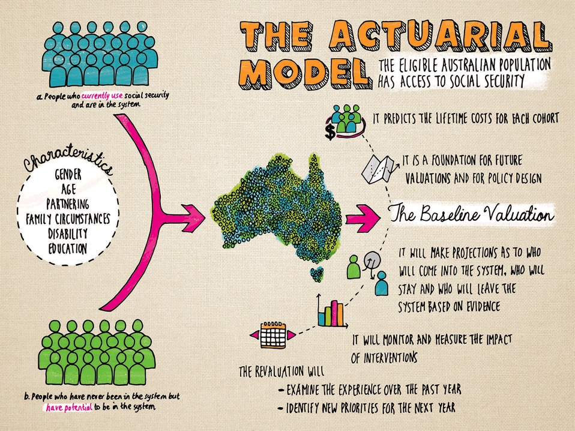
Method Overview

Slide 6
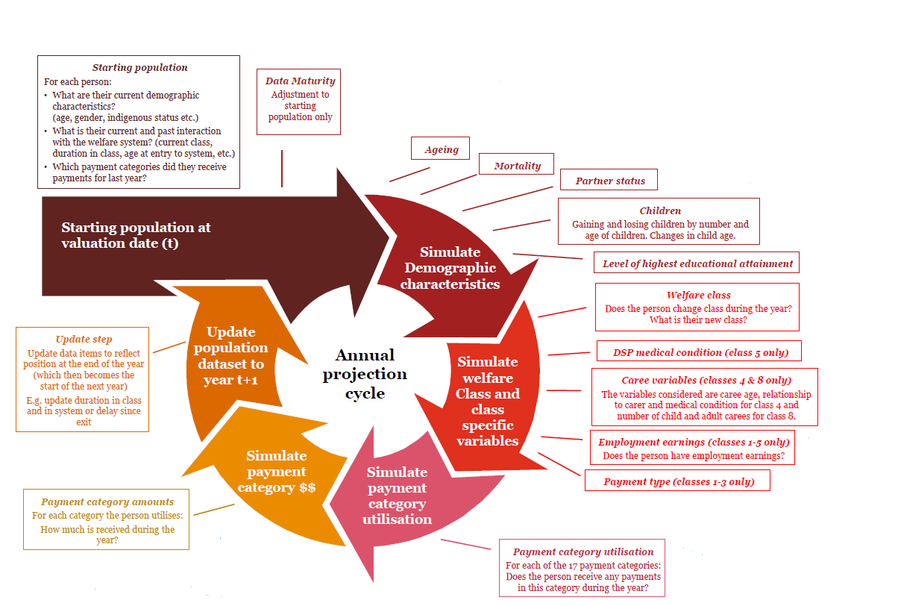
Predictive Model Overview–key steps and assumptions used

Slide 7
What does the predictive analysis tell us?
The Investment Approach uses predictive analysis to:
estimate the future welfare lifetime costs of the entire current Australian population and to identify and respond to trends in benefit receipt.
highlight the key risk characteristics of groups that are most vulnerable to becoming long-term welfare dependent.
examine lifetime costs of benefit receipt and client behaviour including transfers on, off and between benefit states.
test policy approaches to see whether they actually contribute to full, purposeful and self-reliant lives.

Slide 8
Intergenerational welfare dependency
The analysis has also highlighted an intergenerational welfare dynamic that exists.
A significant proportion of young people entering the welfare system for the first time, during their upbringing, had a parent or guardian who also received income support.
Improving lifetime outcomes for today’s welfare recipients could make a massive difference to their own lives, but it can also change and improve the prospects for children and generations to follow.
Findings like these improve our understanding of the transfer of welfare dependence across generations.
This analysis will help us understand why the present structure of the system has not been so effective at reducing the impact of this intergenerational dynamic.

Slide 10
Initial priority groups
Young parents: young people aged under 25 who started receiving Parenting Payment at age 18 or under and who are still receiving an income support payment.
Young carers: young people aged under 25 who are in receipt of Carer Payment or at immediate risk of going onto the payment.
Students at risk of unemployment: young people aged under 25 who have moved, or are at risk of moving, from study (post-secondary or tertiary and been in receipt or receiving a student payment) to an extended period on an unemployment payment.

Slide 11
How the Try, Test and Learn Fund works

Slide 12
The importance of evaluation and co-design
Interventions introduced using a ‘try, test and learn’ approach.
Developing an evaluation/evidence framework is a key element of the co-design process with end users and other key stakeholders.
The predictive analysis will form an important component in determining the effectiveness of interventions and policy settings will be refined on the basis of robust and ongoing evaluation.
Interventions are evaluated to determine “what works for whom” and adjusted, scaled or ceased accordingly.
Interventions could be piloted and refined on a smaller-scale before being scaled to a larger or national level if they are proven effective.

Slide 13
Outcomes-Based Commissioning Approach
Decisions are based on clearly articulated understanding of need and clear and measurable outcomes.
We use and share data, intelligence and evidence to support continual improvement in outcomes that improve wellbeing.

Slide 14
Social Impact Investing
Generating new investments
Social impact investments (SIIs) bring together capital and expertise from across sectors to address complex social problems.
The Government has committed $30 million over 10 years:
$10 million to trial SIIs addressing youth homelessness
$12 million to trial SIIs based on data-driven identification of priority groups
$8 million over four years to develop a sector Readiness Fund

Slide 15
Social Impact Investing
Benefits and impact
Trial new delivery options
Test the value of social impact investing to the Commonwealth
Grow the Australian social impact investing market
More evidence for both the Commonwealth and others in the market on sound social impact investment opportunities
Reduce demand for Commonwealth payments and services

