Slide 1
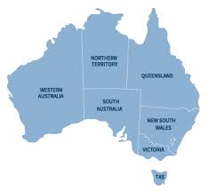
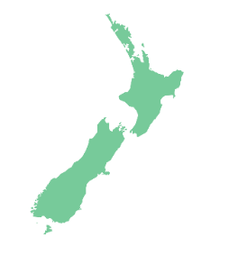
Corked Wine in a Cracked Bottle? ‘Social Investment’ and New Zealand’s welfare reform in Trans-Tasman context
Dr Simon Chapple
AUT Policy Observatory & VUW
simon.chapple@vuw.ac.nz

Slide 2
What’s good and what’s not about “social investment” in NZ
Tomorrow matters, as well as today
Joined-up policy making across agencies
Use of “Big Data” to help inform decisions
No focus on measuring people’s outcomes in making investments, despite rhetoric of their importance
Welfare transfers and real resource costs are treated the same
All win-wins. Trade-offs between equity and efficiency hidden
Flows off a welfare benefit are a good proxy for flows into jobs
All jobs are equally valued
Spending resources on expensive actuaries rather than measuring people’s outcomes

Slide 3
Political architect of social investment in New Zealand
“When government does its job well and intervenes effectively it enables vulnerable people to increase their resilience and social mobility, and it helps them make positive changes to their lives.
It also reduces demand for public services over the medium to long term, and therefore saves taxpayers money.
What works for the community works for the government’s books.”
Bill English, former Minister of Finance, current PM, Annual John Howard Lecture to Menzies Research Centre, 2015

Slide 4
“The purpose of an investment approach is to make the long-term costs transparent and to guide investments to improving employment outcomes and reducing long-term benefit dependency…It is the accompanying social costs that we see alongside the financial costs that are the real concern.” Paula Bennett, former Minister of Social Development, now Deputy PM, 2011

Slide 5
The politics of social investment
Bill English entered Parliament in 1990
National Party, elected in 1990 under the first past the post uni-cameral system (48% popular vote, 69% seats)
Cut welfare benefits and other government spending significantly in 1991
Standard centre-right “smaller government”
Burnt political capital in hope of rapid return
Public rebellion, in part due to this budget, led to the introduction of proportional representation
Since, no majority government in New Zealand

Slide 6
Centre-right problem:
How to achieve goals of reducing the state in an environment of proportional representation and coalition politics? (2014 election, National Party 47% of popular vote)
Answer
Why did the model cross the Tasman? Centre-right government, similar political constraints
The win-win of social investment, with headline rhetorical appeal across the political spectrum

Slide 7
So what’s wrong with social investment win-wins?
Look at what is being done, not the headline rhetoric from Ministers
When the nuts and bolts of NZ social investment are examined, only one win is measured and incentivised
It is the fiscal, re-distributional win. Fiscal redistribution is considered a good proxy for social and economic wins

Slide 8
Key unifying feature of the New Zealand social investment approach so far
Managing and incentivising the working age welfare system providers in terms of the future fiscal liability
At the same time tightening the rules of eligibility and increasing the amount of surveillance of beneficiaries

Slide 9
What is future fiscal liability?
The predicted and discounted future costs in the welfare system of those who have been on a benefit over the reference year
80 percent of liability is welfare benefit payments

Slide 10
Where does fiscal liability come from?
2011 Welfare Working Group
Lessons from insurance industry
Insure against adverse events
Now and future premiums from clients (asset), now and future pay-outs to clients (liability), maximise the difference (net worth)
How good is the analogy?
No asset, only liability
Reduce liability by running down the unobserved assets
Describing people on welfare as a “liability”

Slide 11
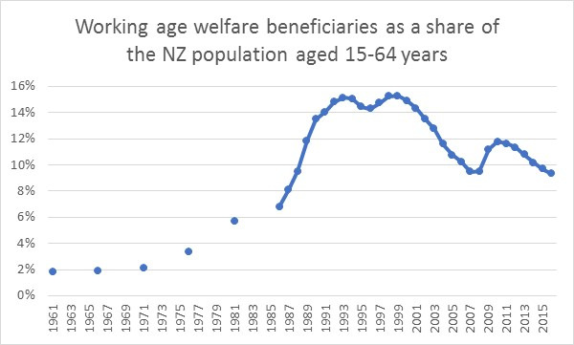

Slide 12
Fiscal focus: Look where the money is going
Amount of money spent on actuaries measuring fiscal liability, 2010 to 2017, probably $10 million NZD>
Amount of money spent on measuring outcomes of people subject to social investment policy, virtually zero

Slide 13
Fiscal focus: Look at the government’s strategic objectives
Better Public Services Goal 1: “Reducing long-term welfare dependence”, via two measurable targets:
Reducing working age client numbers by 25% to 220,000 in 2018
An accumulated actuarial release of $13 billion in 2018
Note neither target is about long-term benefit dependence
Actuarial release=estimate of change in fiscal liability from changes in the number of beneficiaries and their likelihood of long-term benefit receipt. “isolate[s] the impact of collective Government activity on beneficiary numbers”

Slide 14
Fiscal focus: Failure to evaluate welfare reforms, 201-2015
No evaluation plan, no evaluation, despite being the biggest welfare reform for a generation
Argument offered: it is all in the residual fiscal liability change, attributed to reforms and management influence
So nothing more need be examined

Slide 15
Fiscal focus: Look at the Social Investment Unit (SIU)
“Social investment is about improving the lives of New Zealanders by applying rigorous and evidence-based investment practices”
“The SIU has the potential to provide Government with the ability to look across the social sector, and examine particular population groups from a life-course perspective. This will enable a greater focus on the longer-term drivers of fiscal costs, by identifying the connection between some of those cost pressures and particular at-risk groups.”

Slide 16
Fiscal focus means perverse systemic incentives
Benefit take-up
Good jobs, bad jobs, all the same
Not everyone leaves benefit to work
Overall, inefficient decision making

Slide 18
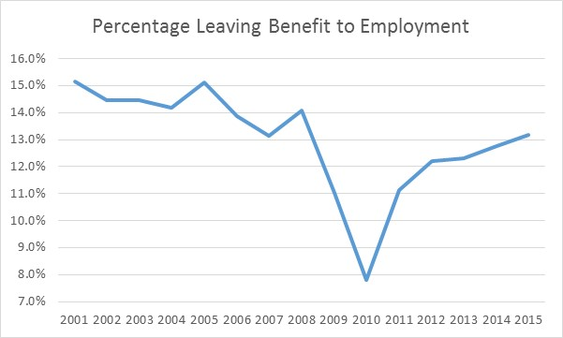

Slide 19
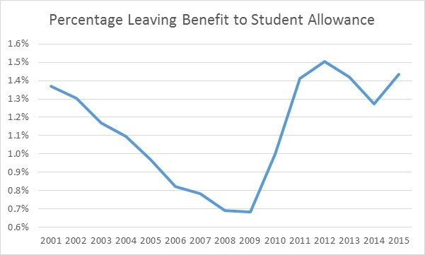

Slide 20
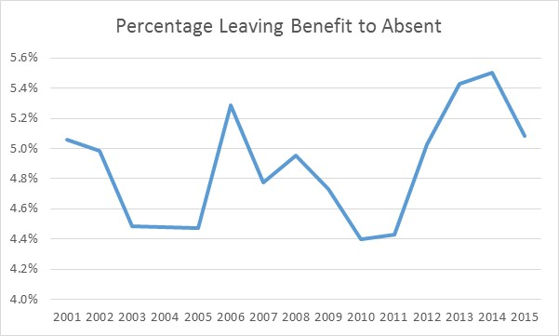

Slide 21
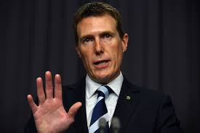
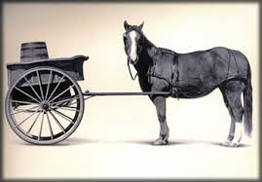
Fiscal liability crosses the Tasman
Priority Investment Approach
“Actuarial valuations…will be used to track the effectiveness of policy interventions” Christian Porter, Minister of Social Services, 2016 Budget
DSS Try, Test, Learn Fund, @ $100 million AUD over four years, aims variously to:
“help people live independently from welfare”
“improve life-time well-being”
and achieve “better outcomes”
TTL “evaluation at the centre of design” but it is unclear what outcomes are sought from the interventions and how they are to be valued. No mention of social cost benefit analysis.

Slide 22
Social cost-benefit analysis and the fiscal redistribution model in the welfare system as competing investment models
 | Social cost-benefit analysis | The fiscal redistribution model
Intellectual origins | Neoclassical public economics | Fiscal accountancy
Outcome to optimise | Efficiency in the use of scarce societal resources at the margin | Intertemporal income redistribution to net taxpayers from net beneficiaries within current tax/benefit rules
Treatment of positive employment outcomes | Valued at gross dollar earnings | Not valued
Treatment of economic efficiency | Explicitly efficiency focussed | Income redistribution from net beneficiaries to net tax payers results in significant trickle down efficiency gains
Treatment of marginal utility of income | Values income gains to poorer people above those to richer people reflecting declining marginal utility of income | Income payments to beneficiaries valued at zero, income losses to net taxpayers are valued dollar for dollar
Treatment of distribution | Explicit information provided on winners and losers, or explicit distributional weights | Income accruing to net tax payers is valued, that accruing to net beneficiaries is not. No additional distributional issues
Treatment of welfare benefits | Re-distributional. Costed at tax deadweight | A dollar-for-dollar cost. No tax deadweight
Treatment of costs | At opportunity cost, including tax deadweight | At accounting cost. No tax deadweight
Treatment of flows over time | Inter-temporal discounting to PV | Inter-temporal discounting to PV

Slide 23
Thank you!

Slide 24
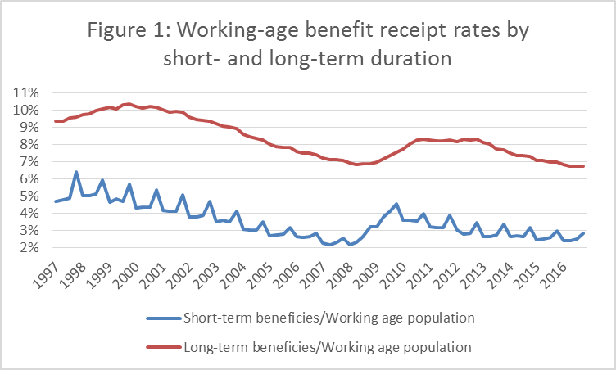

Slide 25
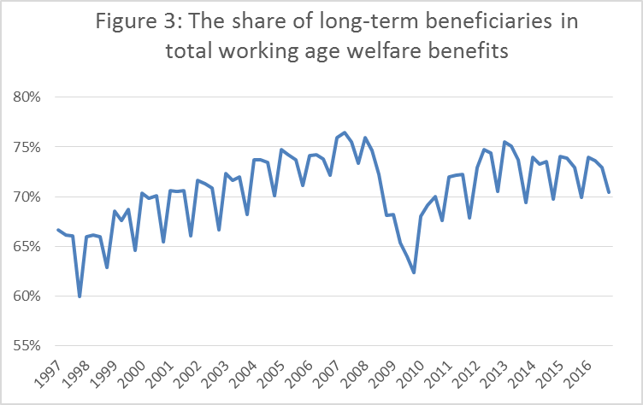

Slide 26
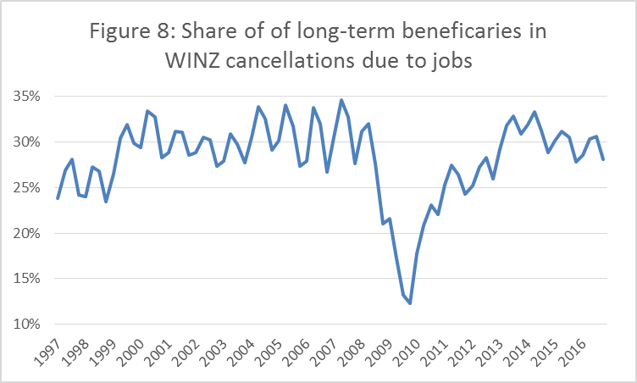

Slide 27
